Slide 1
Benjamin E. Mays High School GO Team Meeting #1
Tuesday, August 22, 2023

Slide 2
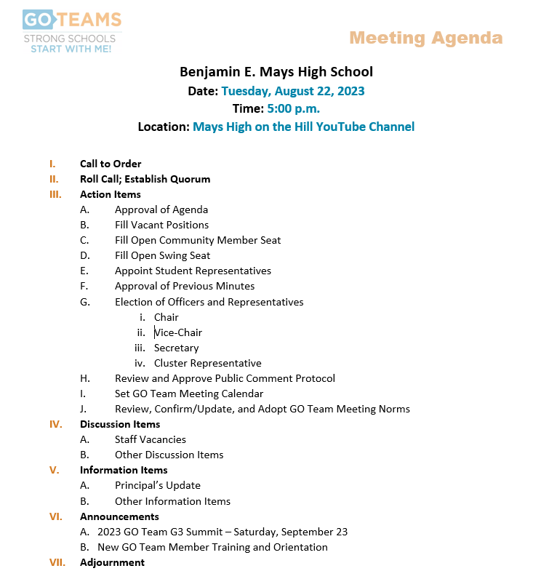

Slide 3
PUBLIC COMMENT FORMAT
For those of you wishing to provide comments, there is time allotted on the agenda during designated meetings as published on the Mays GO Team meeting schedule. If you wish to provide public comment, you must sign up using the Mays Public Comment Form, on the GO Team page of the school’s website, no later than 1 hour prior to the start of the meeting. During the designated time on the meeting agenda, each commenting member of the public will have 2 minutes to speak at which time we will ask you to stop. The Public Comment period is designed to gain input from the public and not for immediate responses by the GO Team to the public comment presented. The public comment period will not exceed 20 minutes, at which time, we will close public comment and move on to the next agenda item. If there are questions or information that you have for the GO Team, you may also contact one or more of the GO Team members after the meeting. You can find GO Team member contact information and meeting dates and agendas on the GO Team page of the school’s website.

Slide 4
Set Meeting Calendar (8 meetings per year vs. 6 meetings per year)
1
2
3
4
5

Slide 5
Meeting Norms

Slide 7
Thank you

